Slide 1
Highlights:
2016 Enrollment Estimates
Board of Higher Education Meeting | October 11, 2016

Slide 2
Third Year of Decline in Last 10 Years
Highlights: 2016 Enrollment Estimates
Peak Year
-10,744 (-5.5%) Decline
from Peak

Slide 3
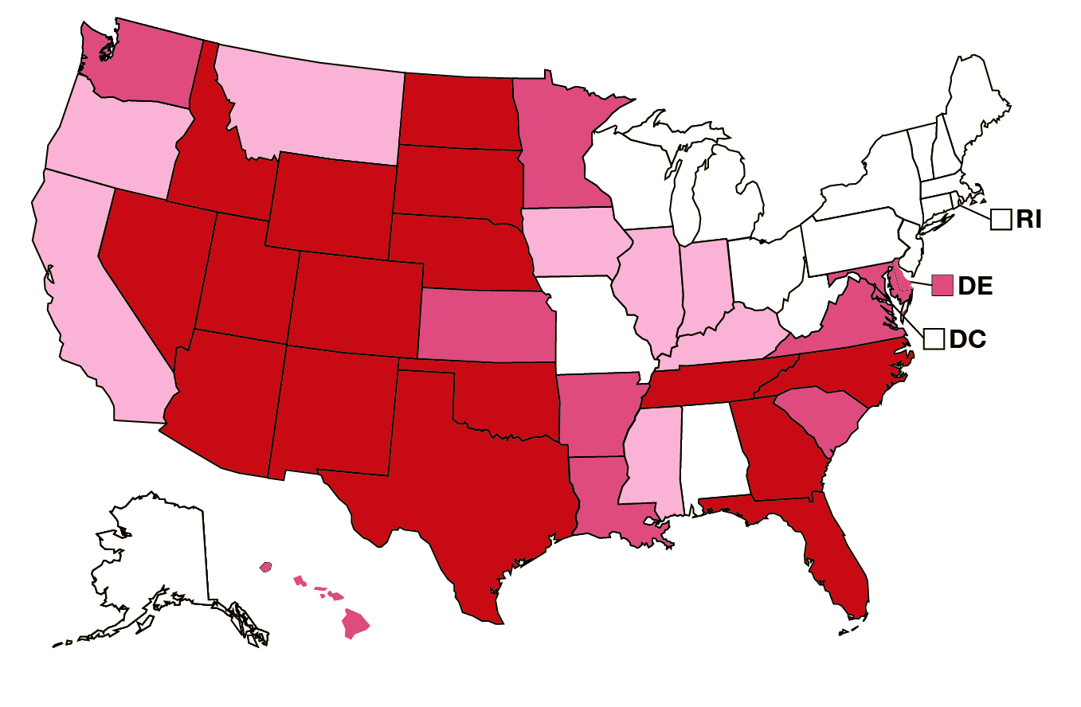
Consensus Among Multiple Projections
Highlights: 2016 Enrollment Estimates
NCES: 2010-2023 Change in
Public High School Graduates
Decline 5% or more
Decline up to 5%
Grow up to 5%
Grow 5% or more
WICHE: High School Graduates
Donahue: Public Higher Ed Enrollments

Slide 4
Enrollment Booms and Busts are Normal
Highlights: 2016 Enrollment Estimates
Source: MA DHE, USDOE

Slide 5
Recent Enrollment Change Varies by Segment
Highlights: 2016 Enrollment Estimates
Peak Year
Peak Year

Slide 6
University of Massachusetts
Highlights: 2016 Enrollment Estimates
Recent increases in undergraduate enrollment associated with notable increase in international student enrollment.
University of Massachusetts Undergraduate Enrollment
 | Fall-2013 | Fall-2014 | Fall-2015 | Fall-2016 | 2015-2016 Change
In-State | 45,668 | 45,924 | 46,418 | 46,614 | 0.7%
Out-of-State | 6,806 | 6,823 | 6,731 | 6,621 | -0.7%
International | 2,162 | 2,630 | 3,150 | 3,680 | 12.4%

Slide 7
State Universities
Highlights: 2016 Enrollment Estimates
Growth in state university undergraduate enrollment has slowed in recent years with slight enrollment declines the last three falls.

Slide 8
Community Colleges
Highlights: 2016 Enrollment Estimates
Accelerated enrollment declines in recent years follow years of unprecedented enrollment growth. Rapid growth from ‘06 to ‘10 coincided with both a boom in high school graduates and the onslaught of the great recession.

Slide 9
Community Colleges
Highlights: 2016 Enrollment Estimates
Historically, community college enrollment has been more volatile than enrollment at the four-year institutions.
Source: MA DHE, USDOE

Slide 10
Community Colleges
Highlights: 2016 Enrollment Estimates
Community College fall enrollment is correlated with
annual enrollment.
Source: MA DHE, USDOE

Slide 11
Profile: New
Undergraduate Students

Slide 12
2015 New Students
t
Profile: New Undergraduate Students
  33,907 Total 2015 New Students Enrolled in Massachusetts Public Higher Education

Slide 13
2015 New Students (cont’d)
t
Profile: New Undergraduate Students
Nearly 52% were female
Average age was 19.9 years
  24.8 years for part-time students
More than 20% were part-time students
Approximately 43% of those enrolling full-time received Pell Grants

Slide 14
Enrollment by Segment
Profile: New Undergraduate Students
More than half of first-time students enroll in Community Colleges, but the share was higher during the recession and enrollment boom.

Slide 15
% Part-Time Student by Segment
Profile: New Undergraduate Students

Slide 16
Average Age by
Enrollment Status & Segment
Profile: New Undergraduate Students

Slide 17
% Female By Segment
Profile: New Undergraduate Students

Slide 18
% Pell Grant Recipient by Segment
Profile: New Undergraduate Students

Slide 19
Race/Ethnicity by Segment
Profile: New Undergraduate Students
Fall 2006
Fall 2015
African American Asian / Pacific Islander Latino/a White

Slide 20
Latino/White Gaps in Attainment
Profile: New Undergraduate Students
Latino/a students are less likely than White students to finish high school and enter college
Sources: MA DESE, MA DHE, National Student Clearinghouse.

Slide 21
Latino/White College-Going Patterns
Profile: New Undergraduate Students
Latino/a recent HS grads are more likely than White recent HS grads to enroll in MA Public Higher Education

Slide 22
Discussion

